Slide 1
Student Residence Management System
By: Brock Young, Jose Contreras, Alikhan Madeni, and Ryan Cropley

Slide 2

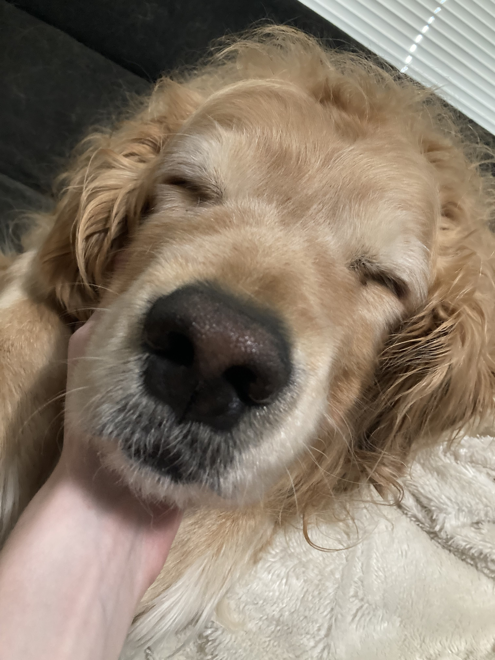


Our team
Brock
Ryan's Dog
Jose
Alikhan
Grunt
Ate his photo
Gacha Player
Wanted to be a woman

Slide 3

Introduction
Developed a Student Residence Management System (SRMS) and related documentation
Address need for modern management tool
Increase key factors such as efficiency, reliability, modifiability, accessibility, scalability, reusability

Slide 4
Design Problem
University requires new software solution to replace existing SRMS
Current paper-based system has issues relating to
Limited scalability
Loss of documents
Large effort for basic tasks
Minimal automation
Lack of easy access to records
Designed solution aims to address above issues with minimal cost and satisfying all design requirements

Slide 5


Objectives & Requirements
Objectives
Availability & Reliability
Modifiability
Scalability
Reusability
Requirements
User Management
Payment Services and Billing
Residence Management
Security & Privacy

Slide 6



Considered Solutions
Solution 1
Solution 2
Solution 3
Initial Logical Model:
Simple design with basic relationships
Managers oversee multiple students, each student only has 1 manager
No controller class
Improved Structure with Controller:
Introduced the SRMS controller class
Removed Bed class to instead make an Bed array within the Residence class
Controller class is missing some required features
Prototype for Final System:
Controller class updated with all required features
Introduced Exception handling
Defines core class structures and key functionalities
Prototype created to view basic user interaction with the system

Slide 7
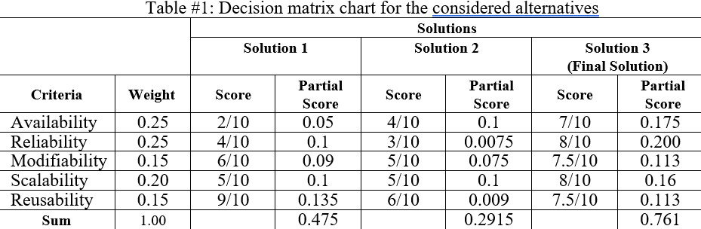
Final Solution
Solution 3 was the most complete
Exception handling
Descriptive class diagram
Highest evaluation against decision matrix

Slide 8




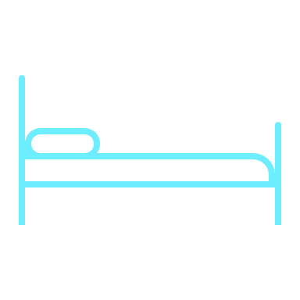
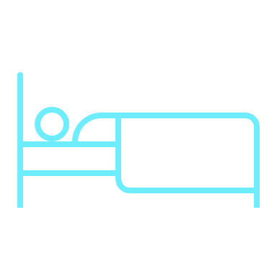


Features
Add Student
Add Manager
Assign Manager
Unassign Manager
addStudent()
addManager()
assignManagerToStudent()
dropAssociation()
Display Empty Beds
Assign Beds
Remove Student
Display Info
displayEmptyBeds()
assignBed()
releaseStudent()
systemState()

Slide 9
Limitations
This is an early prototype model that only contains the essential features.
Therefore we are missing some of the non-essential features
Lack of database
No Remote Access
No login portal
Text based user interface not GUI
Lack of data encryption
Search for users or managers
Lack of Payment services / Billing
No tutorial for navigation

Slide 10




Considerations
ENVIRONMENTAL
SOCIETAL
SAFETY & SECURITY
ECONOMIC
Reduces paper waste
Energy efficient code
Proprietary software
Efficiently scalable
Improve access to housing
Modernize university image
Reduce tedious tasks for staff
Enhance student experience
Reduce risk of data loss
List of managers & students
Handle exceptional cases
Version control for code safety
Save future costs
Satisfy budget constraints
Dynamically scalable
Code reuse in future systems

Slide 11
Conclusion & Future Work
Conclusion
Future Work
Solution served as critical step in advancing universities technological infrastructure & management capabilities
Best solution was evaluated from comparison matrix based on key objectives
Key functionality was established showing successful feasibility study for future iterations
Data Persistence
User Interface
Security Enhancements
Payment Services & Billing
Advanced Search and Filtering
Input Validation and Error Handling
System Remote Access

Slide 12
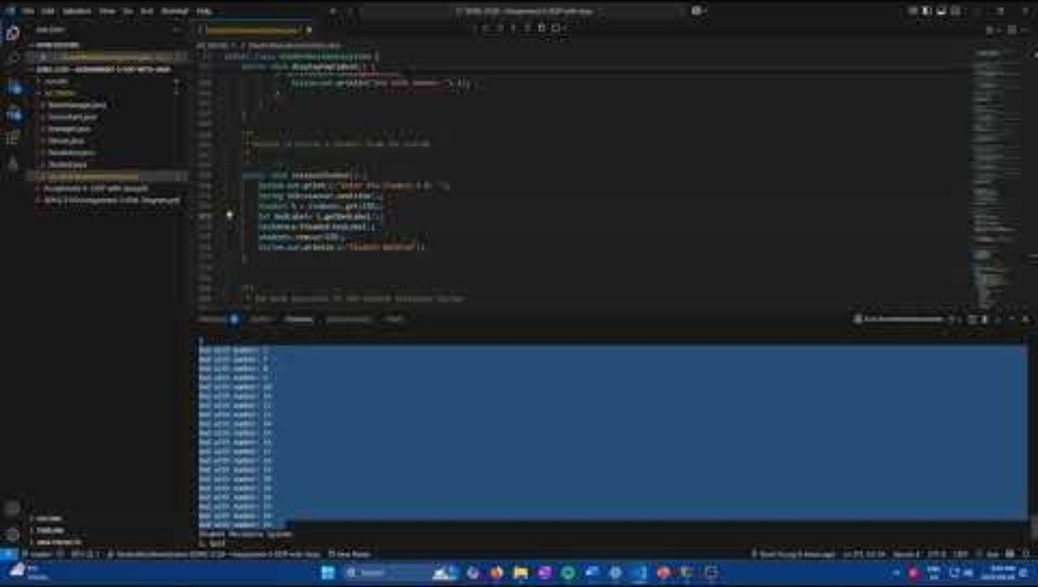
Prototype Video

Slide 13
Thank You

